Slide 1
SOFTWARE ARCHITECTURE AND DESIGN
SENG 307
Module 1- Week 1

Slide 2
Teaching Outline
MODULE 1: SOFTWARE ARCHITECTURE BASIC CONCEPTS
Introduction to Software Architecture Basic Concepts
Software Architecture Recovery
Software Architecture life cycle
Software Architectural Design Decisions
•Software Architectural Structure and Views
Context of Software Architecture and Design
Software rchitecture Versus Software Design
Software Architecture Quality Attributes:
Availability, interoperability, Modifiability, Performance,
Security, Testability, Usability
Other Quality Attributes
Software Architecture Trade-Offs
Software Architectural Styles and Patterns
Presentation: Architecture in the Life Cycle

Slide 3
Basic Definition: What is Software Architecture?
A software system’s architecture is the set of principal design decisions made about the system.
Architecture = {Principal Design Decision}
It is the blueprint for a software system’s construction and evolution

Slide 4
Design Decisions: Design decisions cover all aspects of the system: Structure, Behavior, Interaction, Deployment, Non-functional properties, Implementation
Principal Design Decisions: the “important ones” depending on the goals of the stakeholders
Decisions are made over time
Decisions are changed over time
Decisions depend on other decisions

Slide 5
Why Software architecture?
It creates a solid foundation for the software project
Makes your platform scalable
Increases performance of the platform
Reduces costs, avoids codes duplicity
Enabling and inhibiting quality attributes
Easing communication among stakeholders
Managing change
Providing a reusable model
Imposing implementation constraints

Slide 6
Software Architecture Defined
Software architecture influences every step of software development from the inception to the culmination
A software architecture defines the structure of a system.
A software architecture defines the behavior of a system.
A software architecture defines component relationships.
A software architecture defines communication structure.
A software architecture balances stakeholder’s needs.
A software architecture influences team structure.
A software architecture focuses on significant elements.
A software architecture captures early design decisions.

Slide 7
Prescriptive vs Descriptive Architecture
Software architecture
Set of principal design decisions P about a software system
Prescriptive architecture
Set of architectural design decision P made at time t that reflect architects’ intent
Prescribes what should be true, placing constraints on decisions yet to be made and how the system will be built (as conceived / designed)
Descriptive architecture
Set of artifacts A that realize the design decisions P
Describes what is true, recounting decisions already made about a system’s design and how the system was actually built (as implemented)

Slide 8
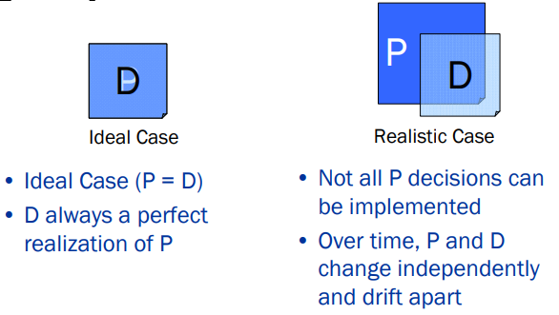
Software Architectural Degradation
The discrepancy between the prescriptive and descriptive architectures. This can be caused by ad-hoc changes in the system artifacts. They have diverged.
Eventually leads to architectural decay

Slide 9
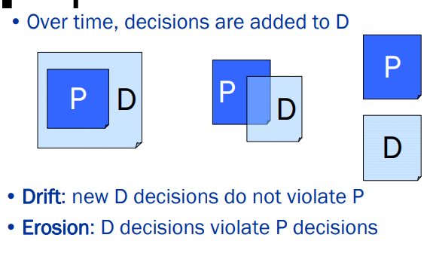
Degradation Process: From Drift to Erosion

Slide 10
Software Architectural Degradation
Architectural Drift
The introduction of principle design decisions into the system's descriptive architecture that is not even implied by the prescriptive architecture but doesn’t violate any of the current prescriptive architecture's design decisions.
Architectural Erosion:
The introduction of principle design decisions into the system's descriptive architecture that violates its prescriptive architecture
Architectural Decay:
When the concrete (as-built) architecture of a software system deviates from its conceptual (as-planned) architecture where it no longer satisfies the key quality attributes that led to its construction
Drift
Erosion
Decay
Notes:
Architectural drift: introduction of principal design decisions into a system’s descriptive architecture that are not included in, or implied by the prescriptive architecture
Implementation of a program diverges from the initial design and purpose.
The problems it brings are similar to erosion; it will be increasingly difficult to further develop, maintain or even understand the code because design decisions are not always apparent when only looking at the code.
To prevent architectural drift, there needs to be some kind of communication between the system designers and the implementers such as having the designers follow the progress of the implementation or having the implementers carefully document their work.
Architectural erosion: introduction of architectural design decisions into a system’s descriptive architecture that violate its prescriptive architecture.

Slide 11
Importance of Software Architecture
Structural foundation
Guideline for decision making
Quality Assurance
Modularity and Reusability
Communication and collaboration
Risk Mitigation
Scalability, Maintainability and Extensibility
Documentation and Knowledge Transfer
Compliance and Security

Slide 12
Limitations of Software Architecture
Software architecture is still an emerging discipline within software engineering. It has the following limitations:
Lack of tools and standardized ways to represent architecture
Lack of analysis methods to predict whether architecture will result in an implementation that meets the requirements.
Lack of awareness of the importance of architectural design to software development
Lack of understanding of the role of software architect and poor communication among stakeholders.
Lack of understanding of the design process, design experience and evaluation of design

Slide 13
Roles of a Software Architect
Interact with clients, product managers, and developers to envision, model, and design the software solution. A software architect advocates clarity and transparency between the client and the team.
Perform regular code reviews to ensure the design quality and avoid overly complicated structures. These tasks usually involve hands-on work on prototype development, code contributions, or technological assessment.
Ensure software meets all requirements of quality, security, modifiability, extensibility etc.
Collaborating with other professionals to determine functional and non-functional requirements for new software or applications

Slide 14
Architectural Decay and Recovery
Architecture decay is essentially the result of software evolution. The process of evolution increases brittleness in the system increasing its resistance to change.
The design of a system becomes less and less suitable with every new version of software to incorporate new features. The process of maintenance worsens the situation
Architectural Recovery is the process of determining and restoring a software system's architecture from its implementation-level artifacts.

Slide 15
Architectural Recovery
If architectural degradation is allowed to occur, one will be forced to recover the system’s architecture sooner or later
Architectural recovery is the process of determining a software system’s architecture from its implementation-level artifacts.
It deals wit recover of past designs decisions
Implementation-level artifacts can be
Source code
Executable files
Java .class files

Slide 16
Challenges of Architectural Recovery
If architectural degradation is allowed to occur, one will be forced to recover the system’s architecture sooner or later
Architectural recovery is the process of determining a software system’s architecture from its implementation-level artifacts
Implementation-level artifacts can be
Source code
Executable files
Java .class files

Slide 17
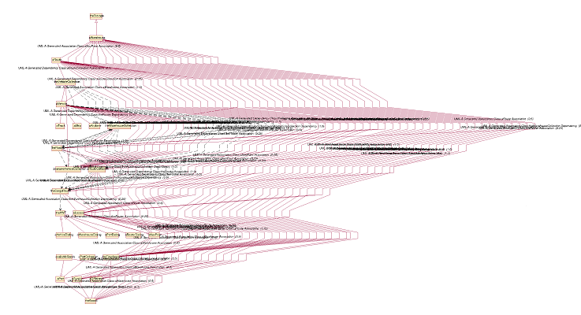
Implementation-Level View of an Application
Software Architecture: Foundations, Theory, and Practice; Richard N. Taylor, Nenad Medvidovic, and Eric M. Dashofy; © 2008 John Wiley & Sons, Inc. Reprinted with permission.

Slide 18
Implementation-Level View of an Application
Complex and virtually incomprehensible!
Software Architecture: Foundations, Theory, and Practice; Richard N. Taylor, Nenad Medvidovic, and Eric M. Dashofy; © 2008 John Wiley & Sons, Inc. Reprinted with permission.

Slide 19
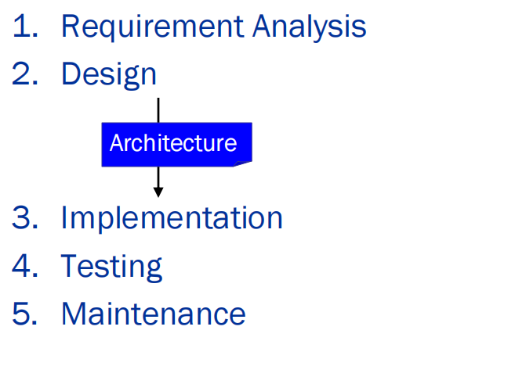
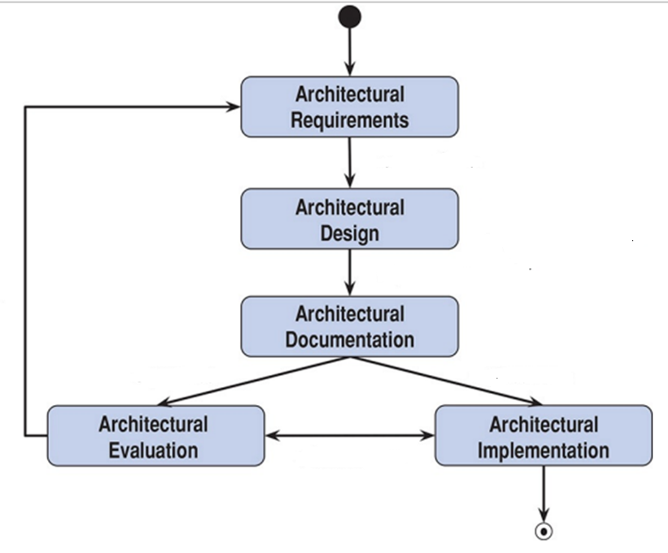
Architecture within the Software Development Process
Software Architecture Life Cycle
Waterfall Model

Slide 20
Software Architecture Life Cycle

Slide 21
Architectural Processes
Architectural design
Architecture modeling and visualization
Architecture-driven system analysis
Architecture-driven system implementation
Architecture-driven system deployment, runtime redeployment, and mobility
Architecture-based design for non-functional properties, including security and trust
architectural adaptation

